Slide 1


Job scope
Data Analysis

Slide 2
Names :
Supervisor : Dr Amal Mahmoud
student project :
1- Bishoy Victor Nabil
2- Ayman saadan
3-Ebram Effat
4-Amgad Abdelhamid Hamza

Slide 3
Introduction
The technology sector in Egypt has been experiencing significant growth, with increasing demand for skilled professionals across various roles. As the job market evolves, understanding compensation trends and the factors influencing salaries becomes crucial for job seekers, employers, and decision-makers. The "Job Scope" project was initiated to provide a data-driven analysis of compensation and job roles in the Egyptian technology sector, leveraging data scraped from a popular job website.

Slide 4
TOOLS :
Python
SQL
Tableau
Excel

Slide 5
Objective of the Project:
The primary objective of the "Job Scope" project is to analyze compensation trends and job market dynamics within the Egyptian technology sector.
By leveraging data scraped from a leading website on the Egyptian job market, this project seeks to uncover insights about compensation patterns, job roles, industry focus, and diversity in the tech industry.
Our analysis aims to assist stakeholders—such as job seekers, employers, and policymakers—by providing a clearer understanding of the factors influencing salaries and job opportunities in Egypt’s tech landscape.

Slide 6
1. Compensation Analysis:
What is the average compensation by business market, business size, or industry?
Are there observable patterns in compensation based on years of experience (YOE), job title, or education level?
How do compensation ranges vary by location or work setting (remote, hybrid, in-office)?

Slide 7
2. Job Role and Market Insights
What are the most common job titles across business markets and industries?
How does business focus (e.g., software, finance, etc.) influence job roles or programming languages used?

Slide 8
3. Diversity and Inclusion:
Is there any gender pay gap within different business markets, industries, or job titles?
How does gender representation vary across job titles, business lines, or company sizes?

Slide 9
4. Experience and Education:
Does having a degree affect compensation or career level progression?
How does compensation grow with years of experience across different job roles or industries?
Insight: Analyzing how education and experience impact career progression offers guidance for professionals looking to maximize their earning potential.

Slide 10
5. Geographical Insights:
What are the trends in compensation by company location?
Are there regional differences in business focus or types of roles hired?

Slide 11
6. Work Setting and Flexibility:
How does work setting (remote, hybrid, in-office) impact compensation, job titles, or business focus?
What are the trends in work settings across different industries or business sizes?

Slide 12
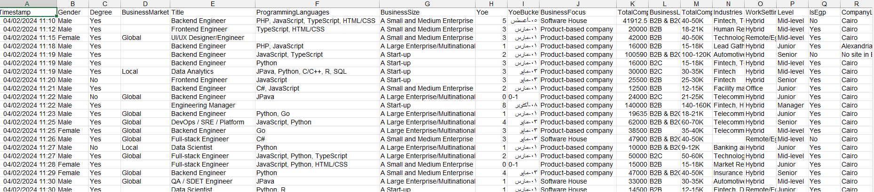
Discover Data

Slide 13
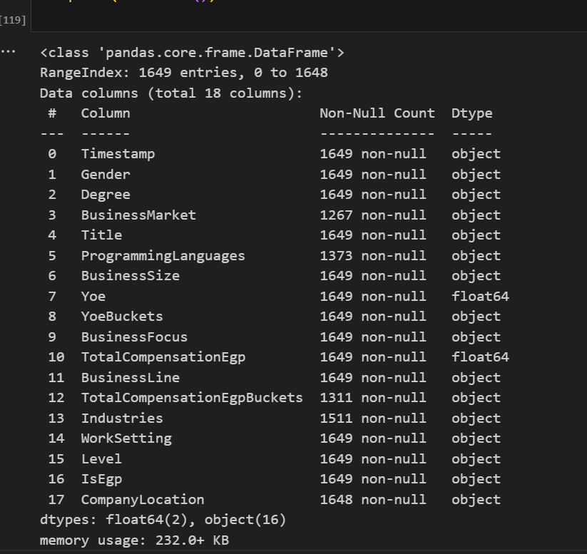
Discover Data

Slide 14
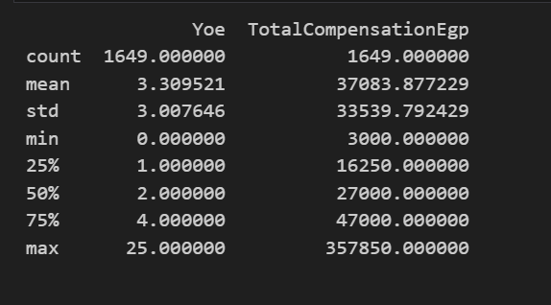
Data Describe

Slide 15
Data Cleaning

Slide 16
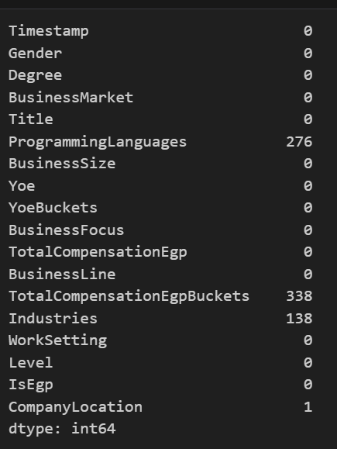
Missing value

Slide 17
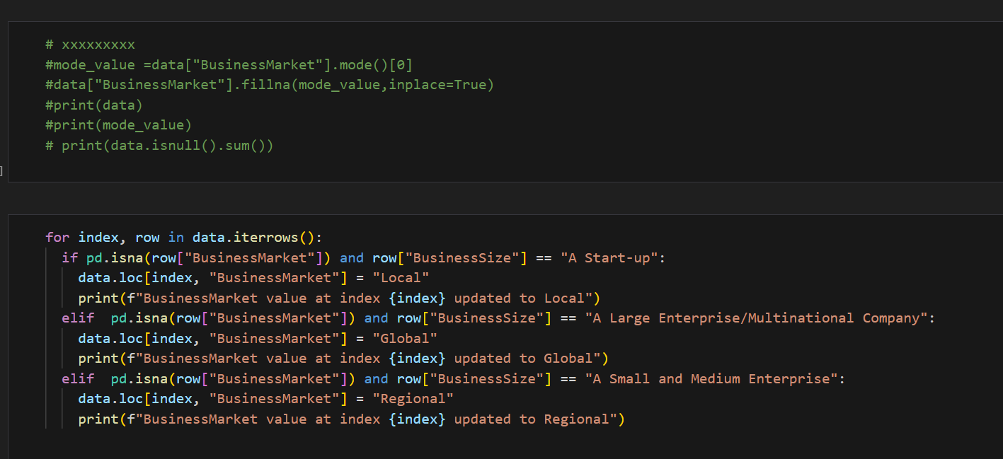
Filling (Business_Market) missing values

Slide 18
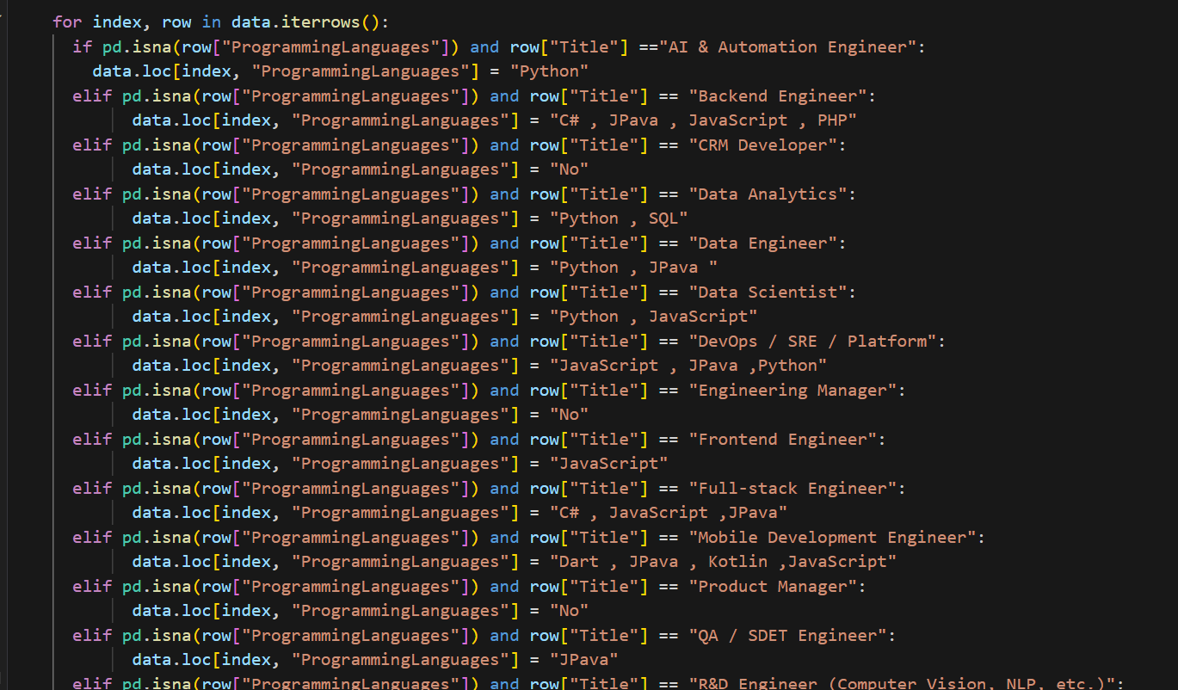
Filling (programming lang) missing values

Slide 19
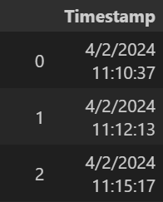
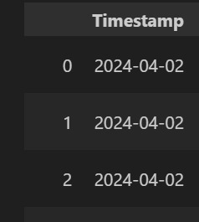
Editing and Delete time

Slide 20
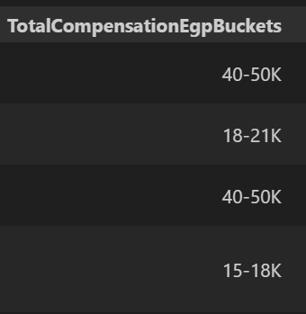
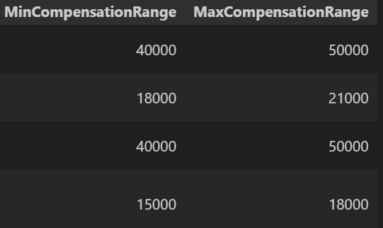
Split column
delete k
multiply *1000

Slide 21
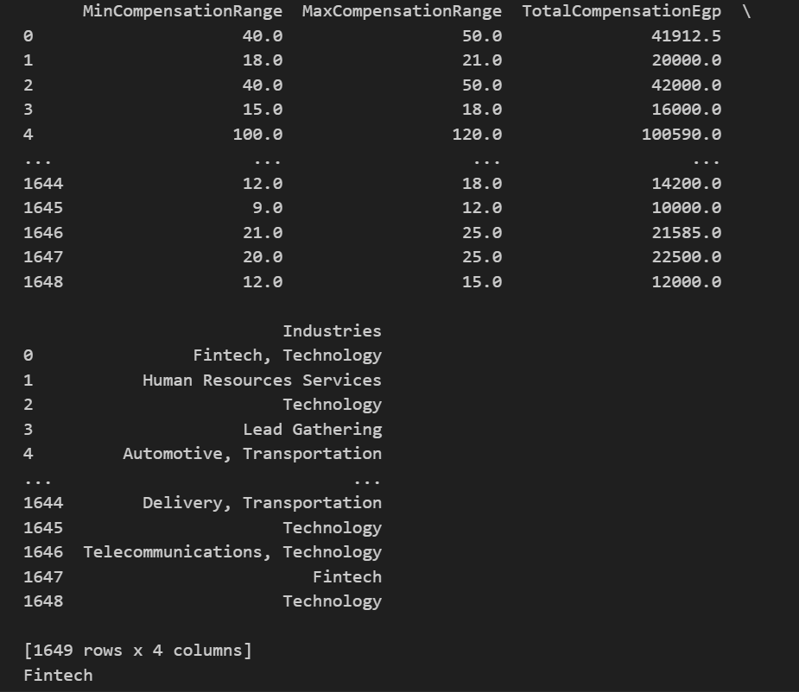
Filling missing value of industry

Slide 22
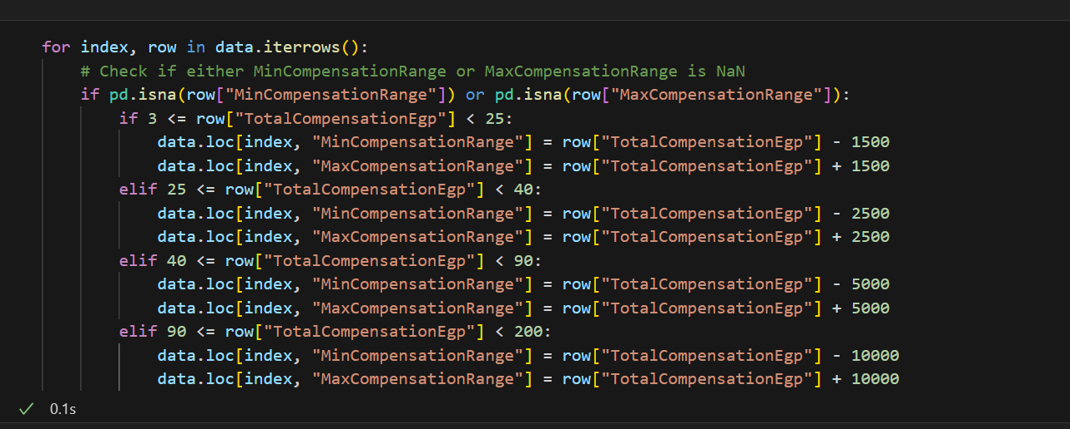
Fill missing value min and max

Slide 23
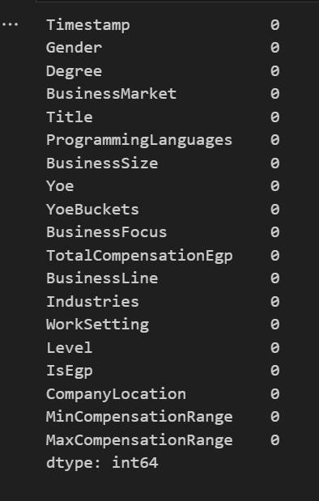
Data is cleaned

Slide 24
Analysis data

Slide 25
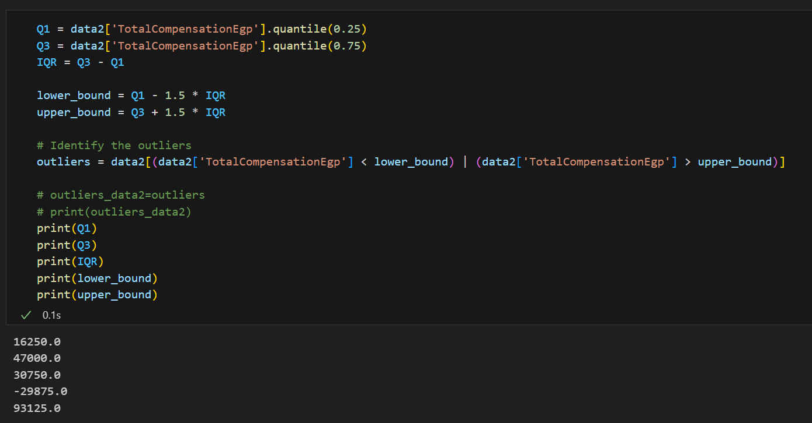
Detecting outliers

Slide 26
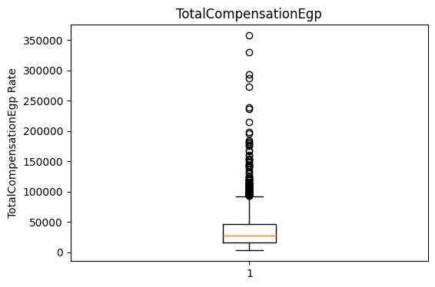
Explore outliers

Slide 27
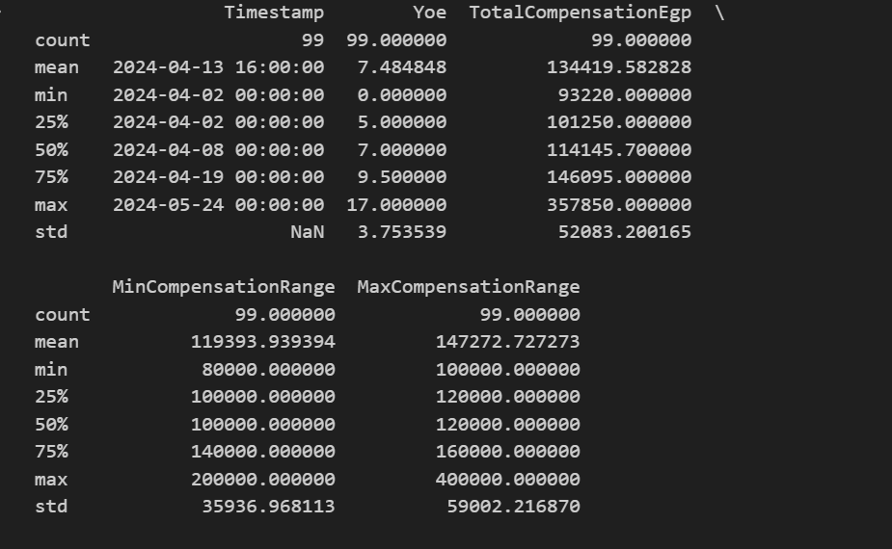
Describe outliers

Slide 28
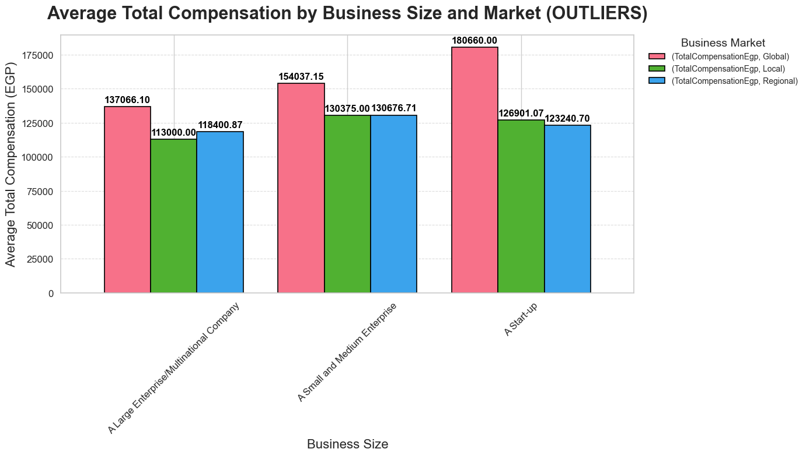
Average Total Compensation by Business Size and Market (OUTLIERS)

Slide 29
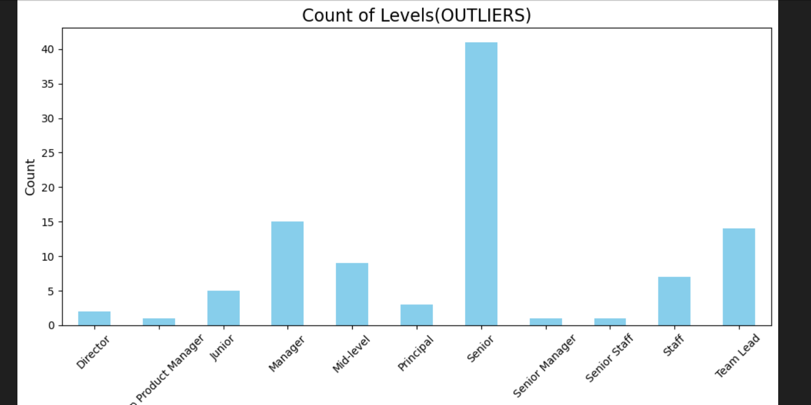
Count of Levels(OUTLIERS)

Slide 30
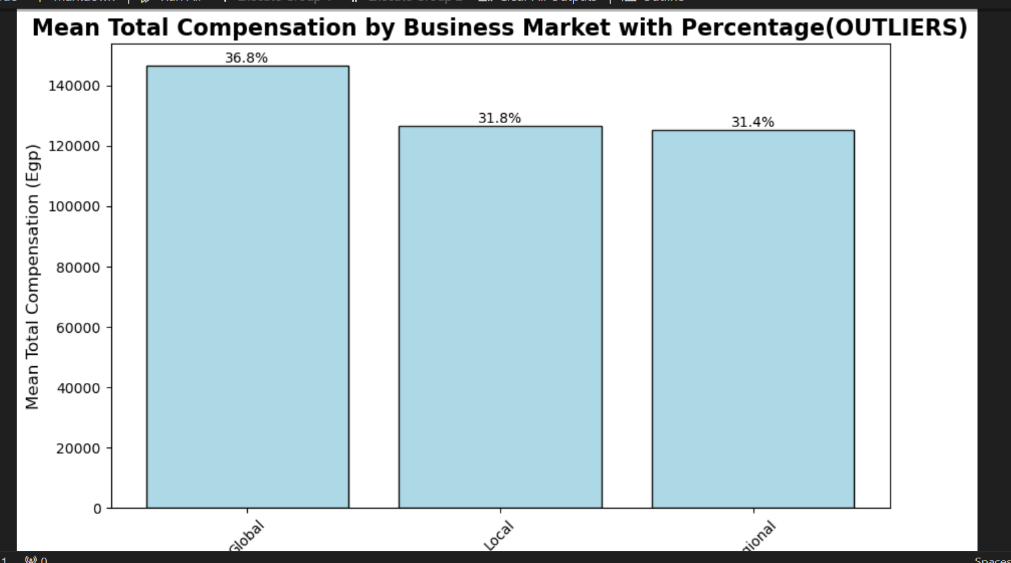
AVG Total Compensation by Business Market with Percentage(OUTLIERS)

Slide 31
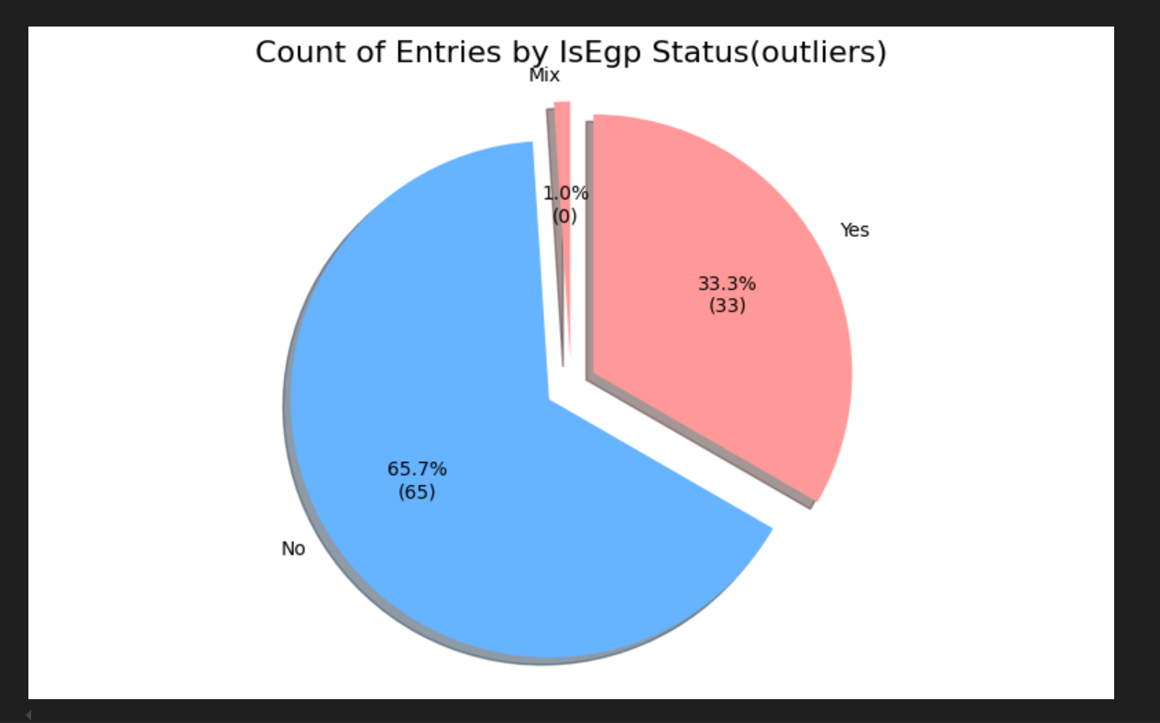
Count of Entries by IsEgp Status(outliers)

Slide 32
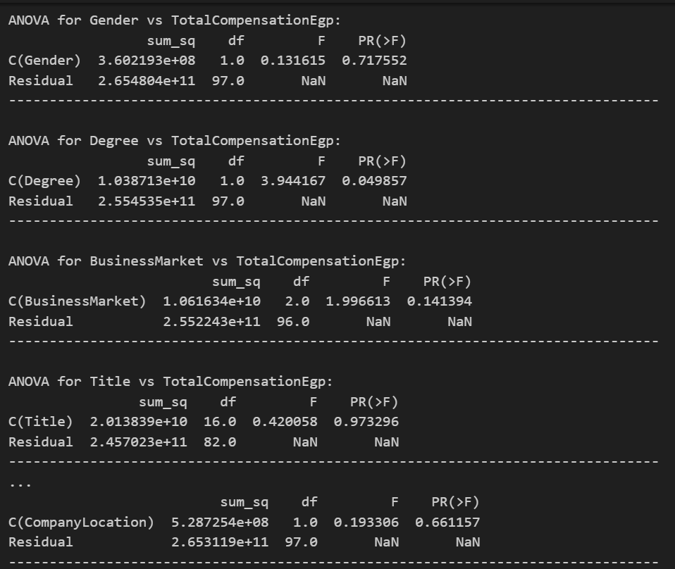
ANOVA OUTLIERS

Slide 33
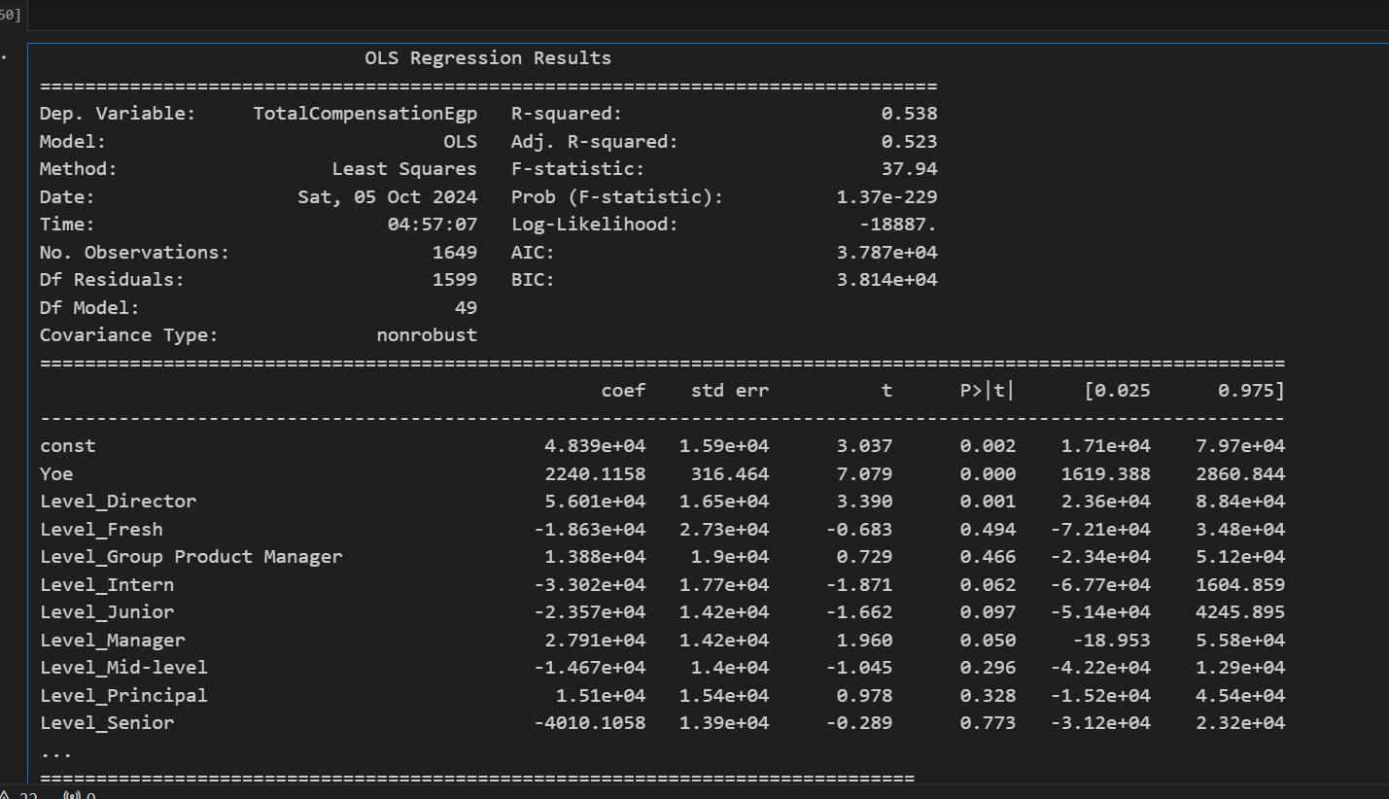
Regression data

Slide 34
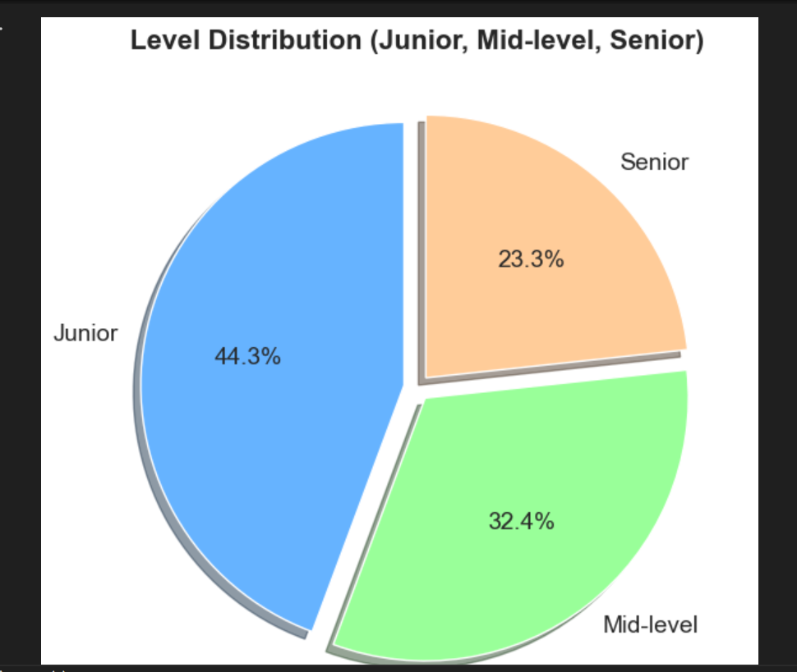
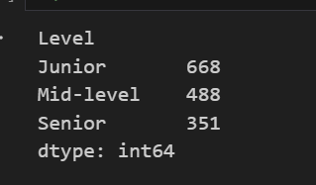
Level Distribution (Junior, Mid-level, Senior) All data

Slide 35
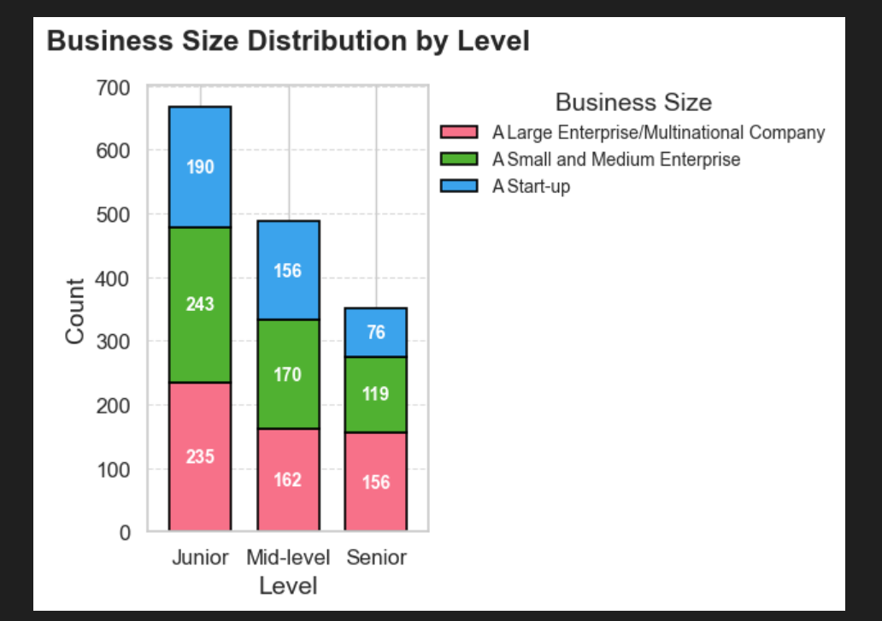
Business Size Distribution by Level

Slide 36
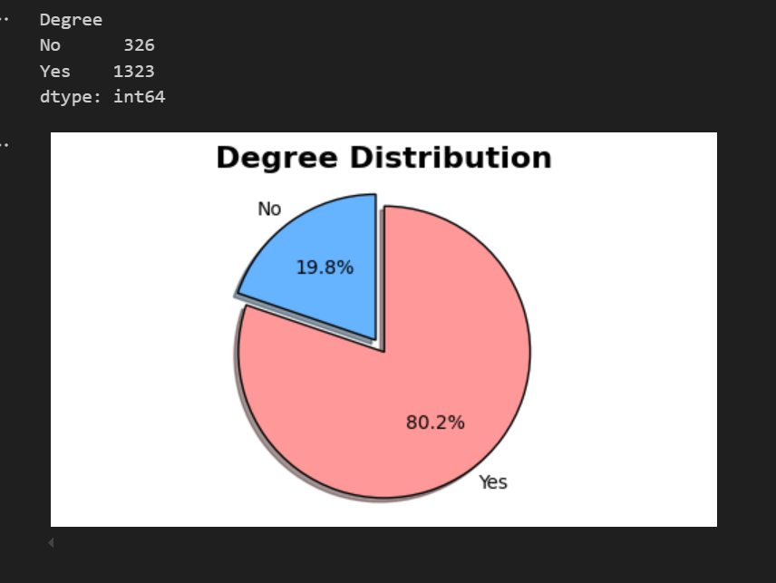
Degree Distribution

Slide 37
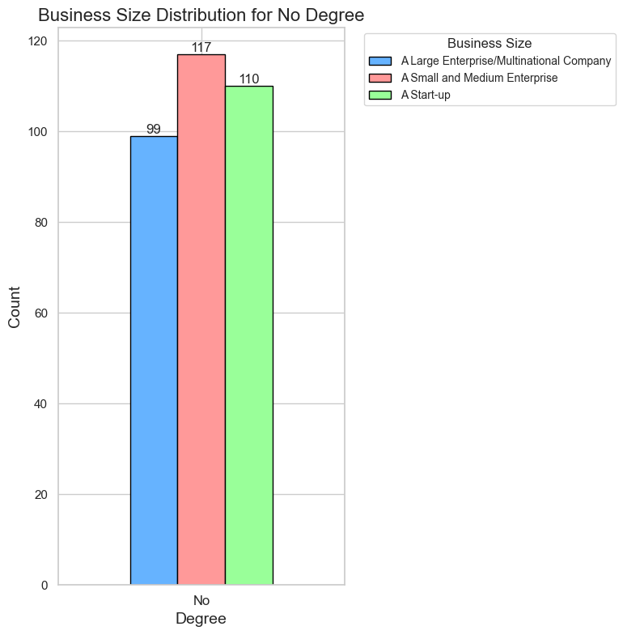
Business Size Distribution for No Degree

Slide 38
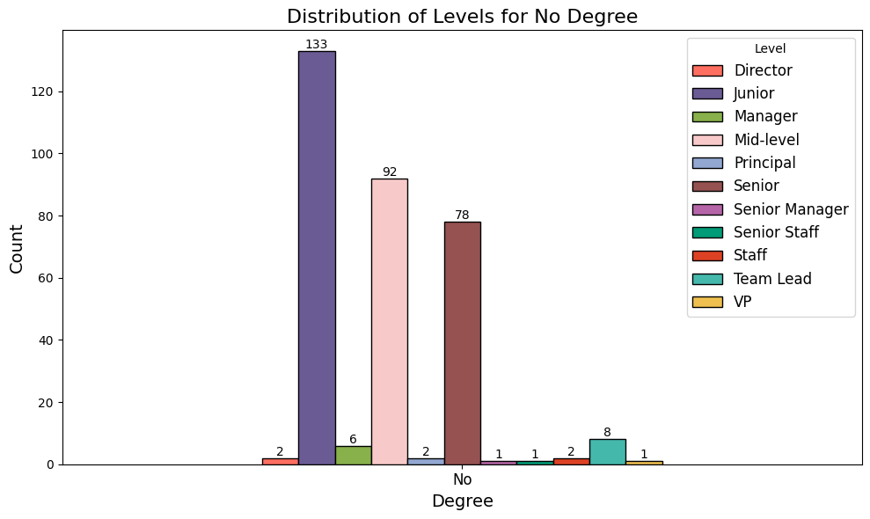
Distribution of Levels for No Degree

Slide 39
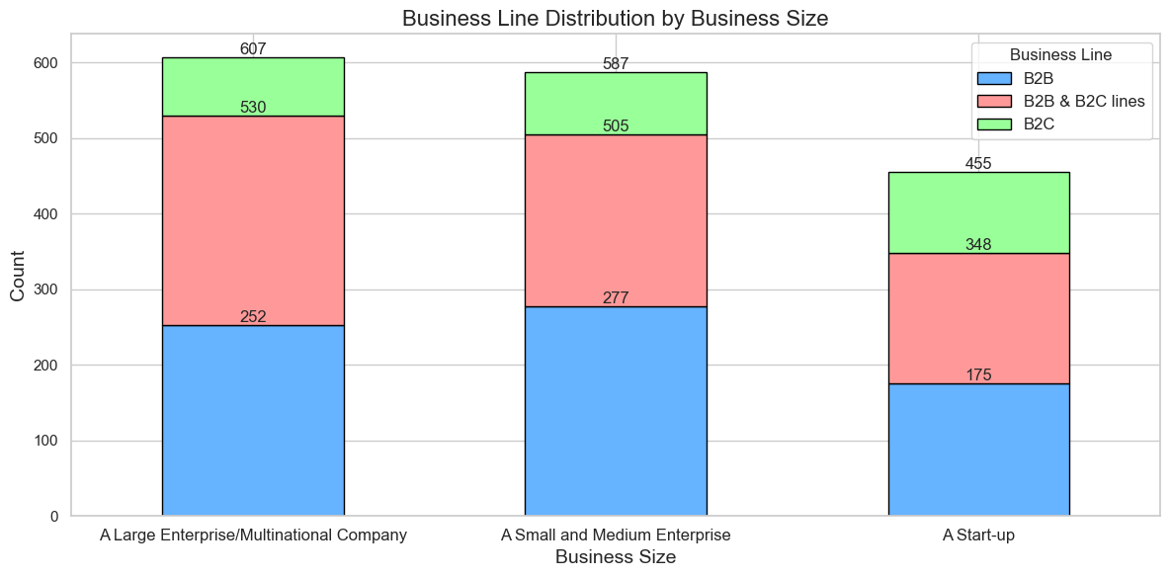
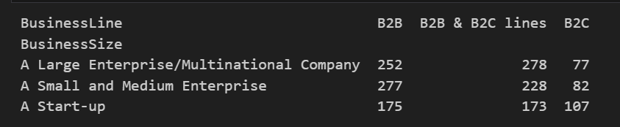
Business Line Distribution by Business Size

Slide 40
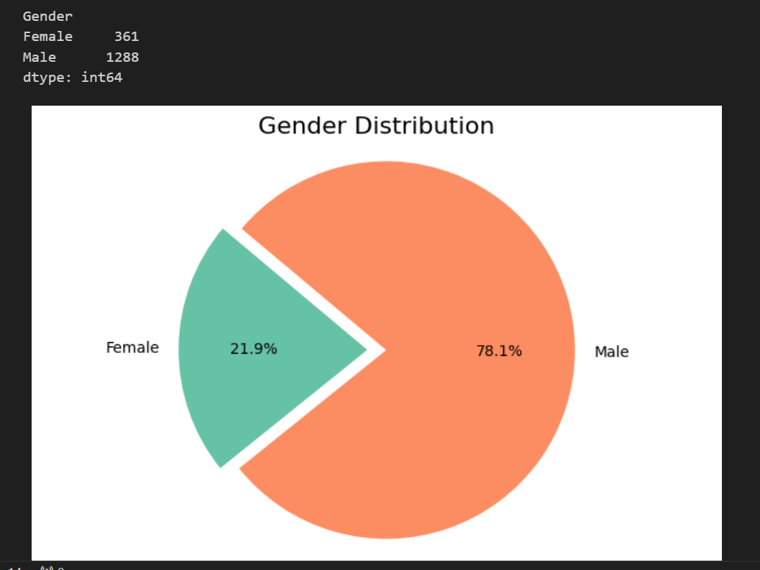
Gender Distribution

Slide 41
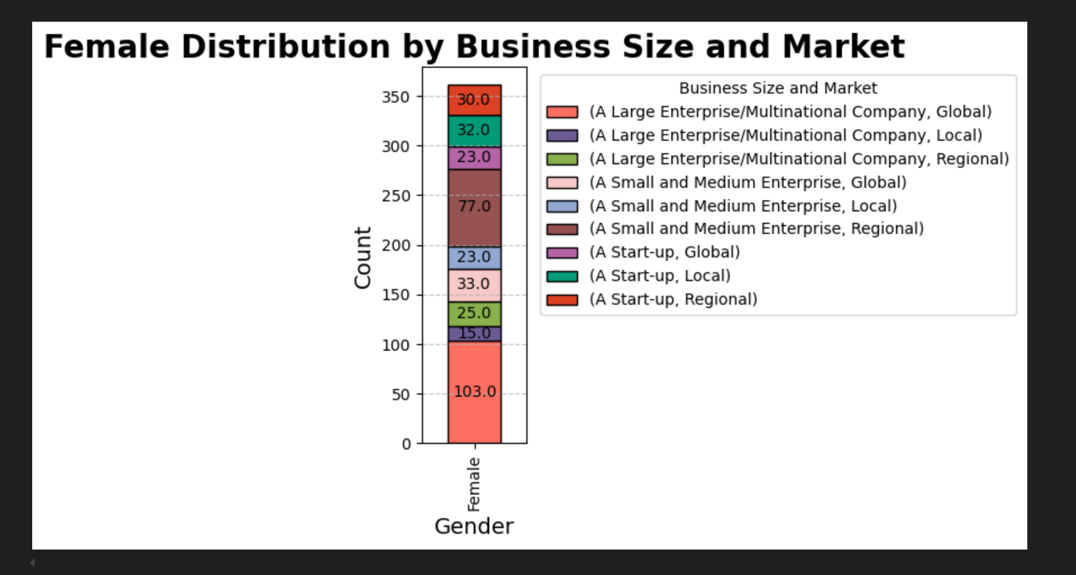
Female Distribution by Business Size and Market

Slide 42
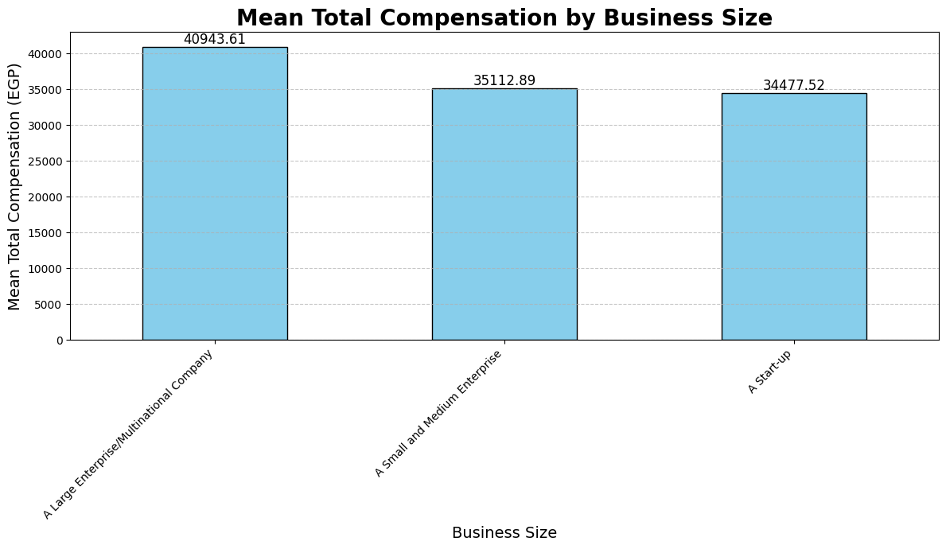
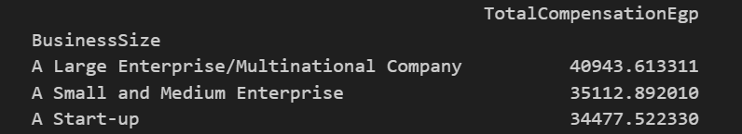
AVG Total Compensation by Business Size

Slide 43
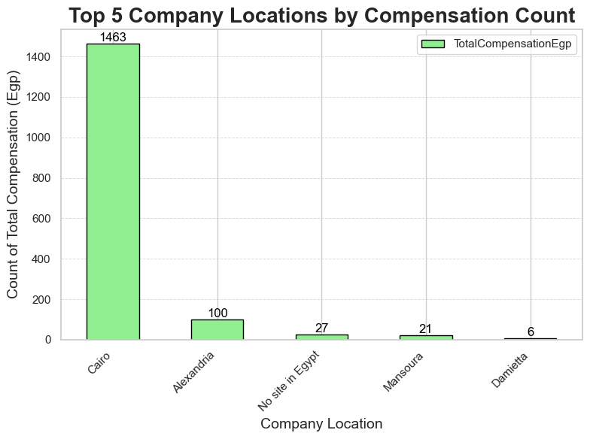
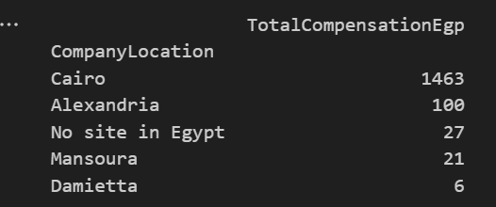
Top 5 Company Locations by Compensation Count

Slide 44
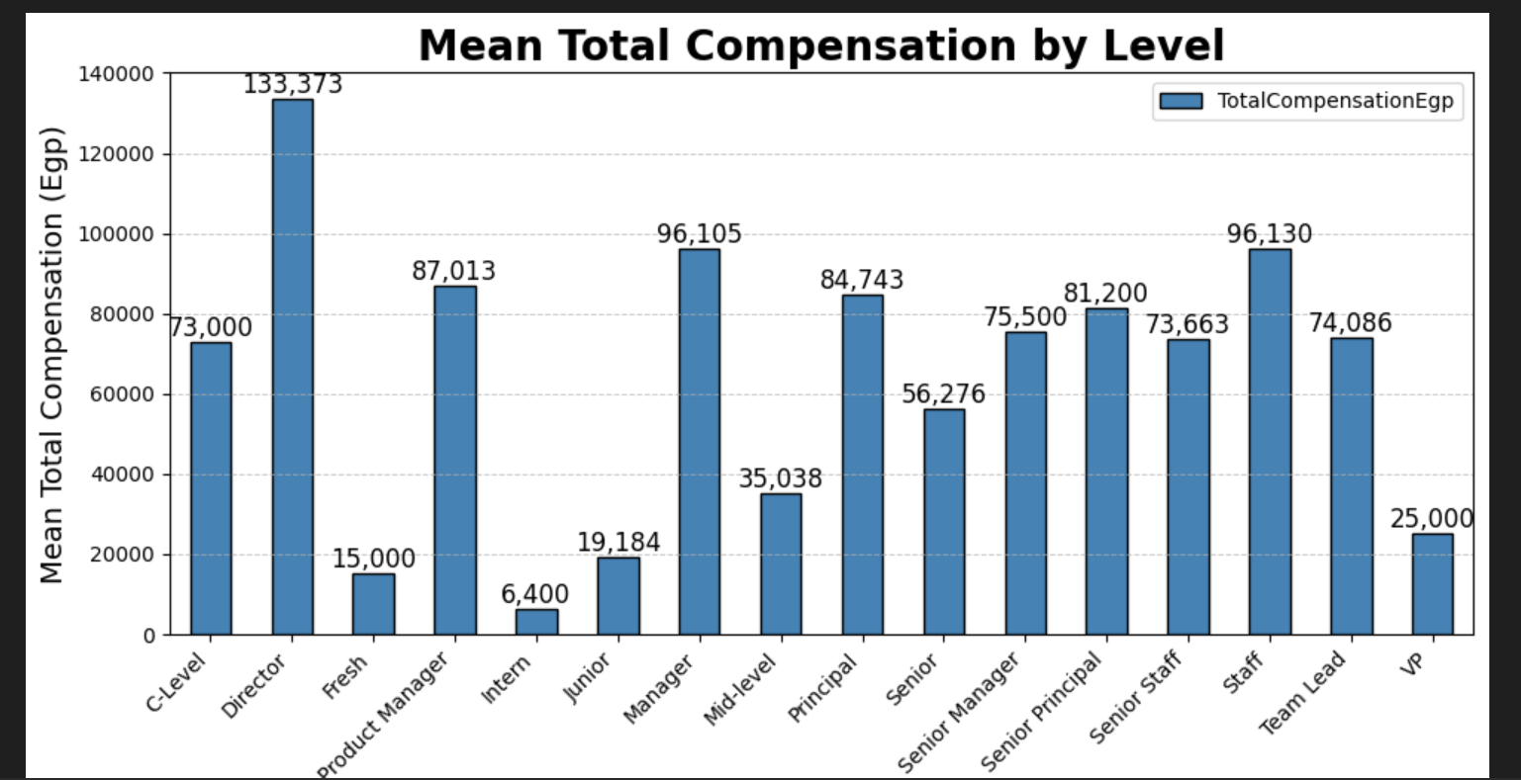
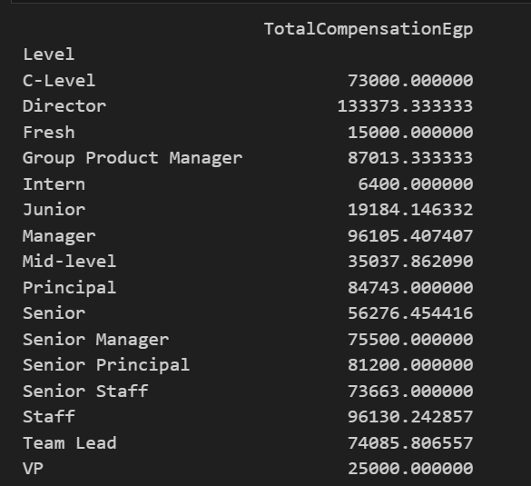
AVG Total Compensation by Level

Slide 45
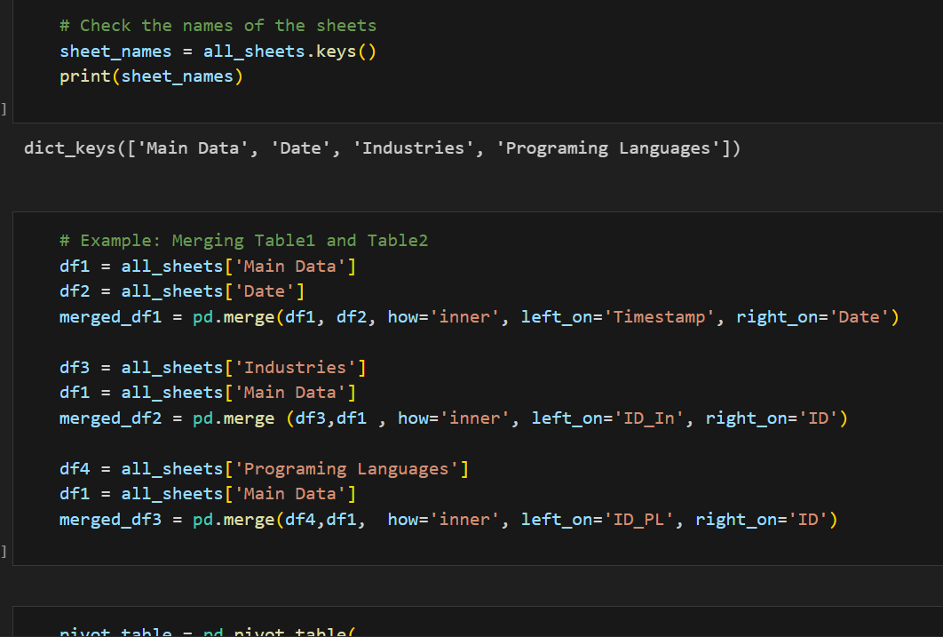
Merge 4 Sheets In Python

Slide 46
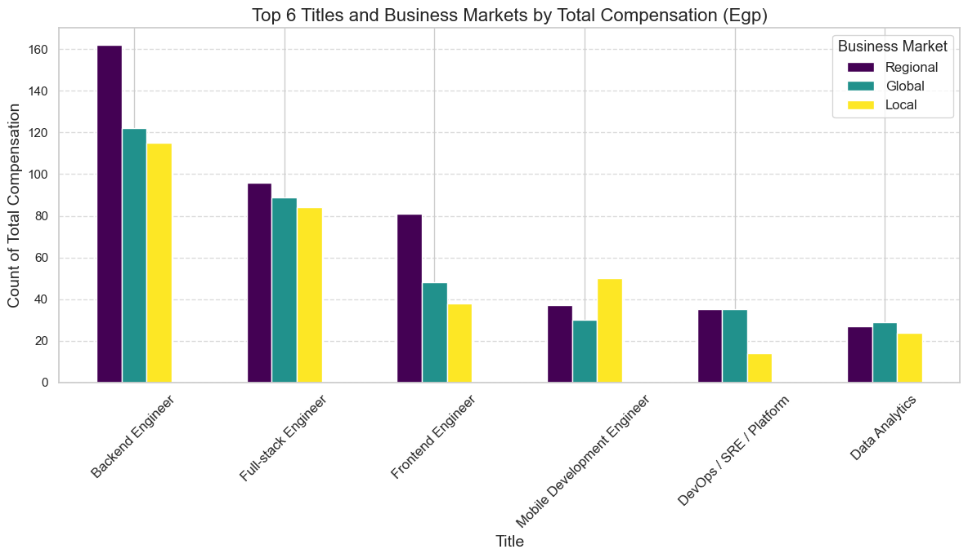
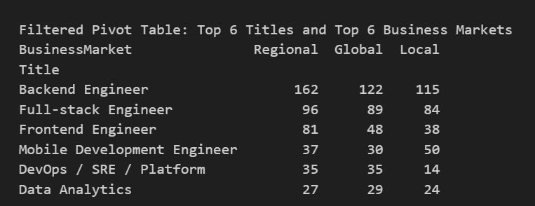
Top 6 Titles and Business Markets by Total Compensation (Egp)

Slide 47
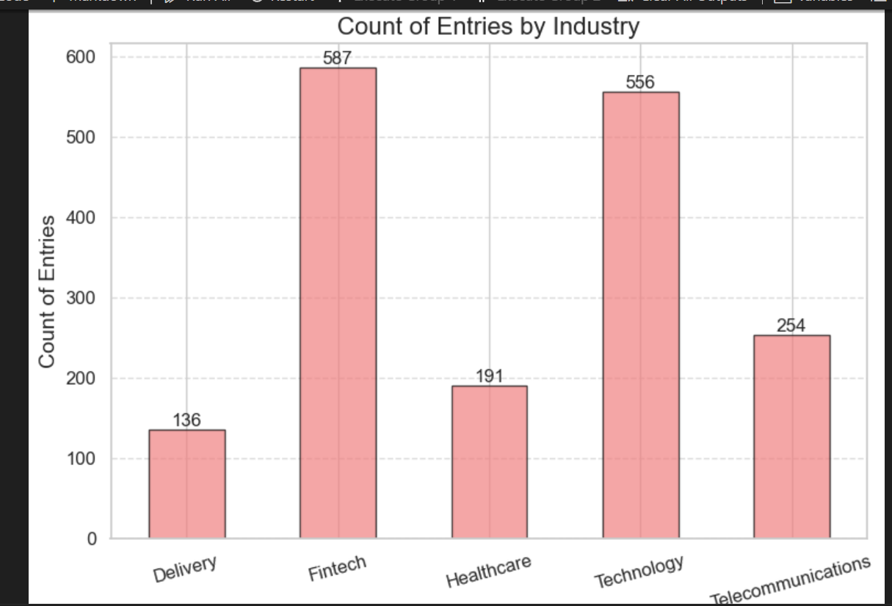
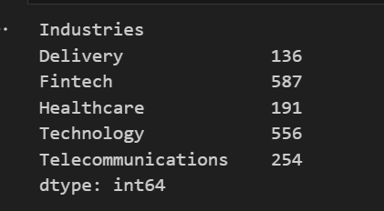
Count of Entries by Industry

Slide 48
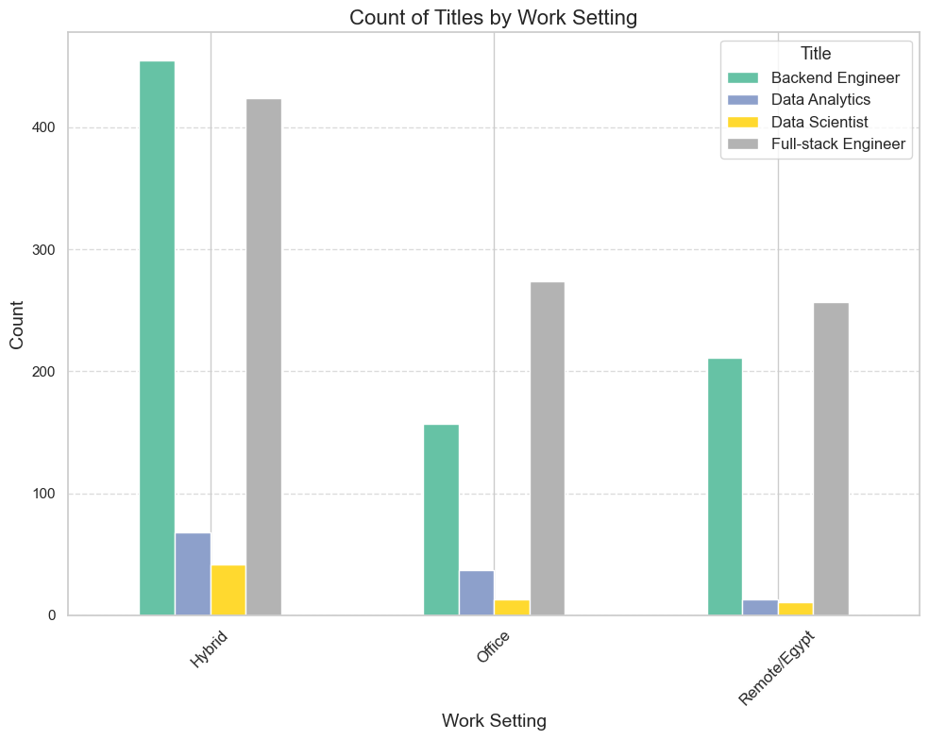
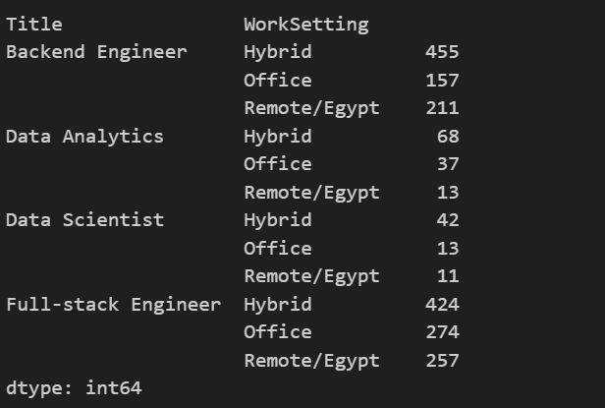
Count of Titles by Work Setting

Slide 49
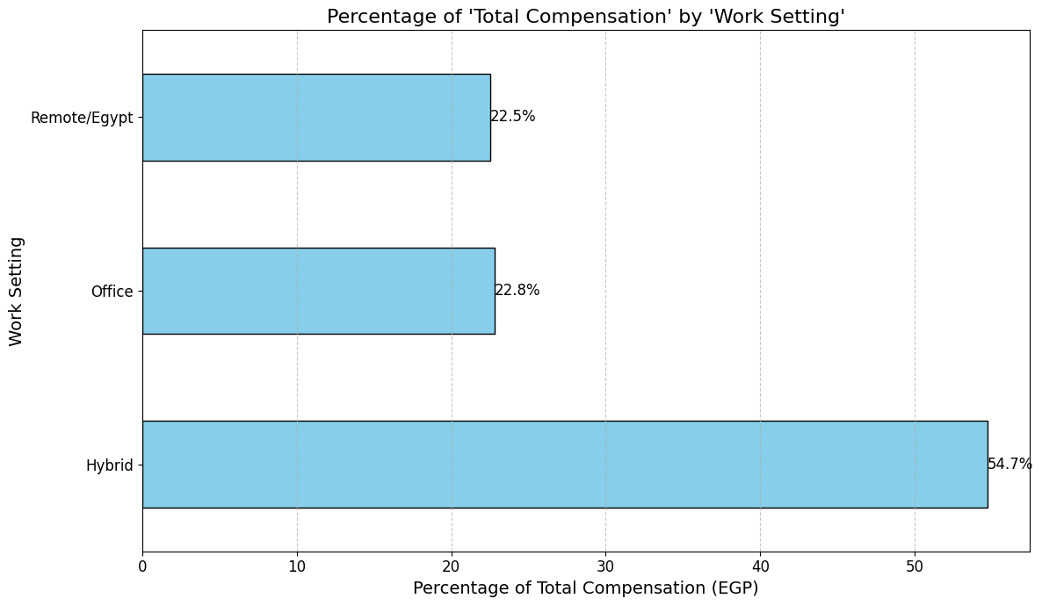
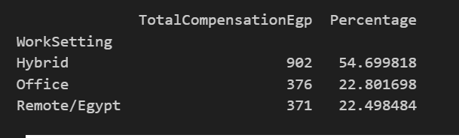
Percentage of 'Total Compensation' by 'Work Setting'

Slide 50
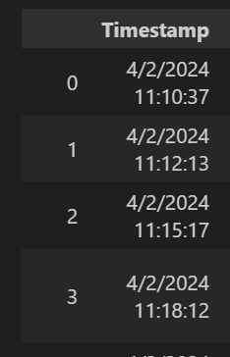
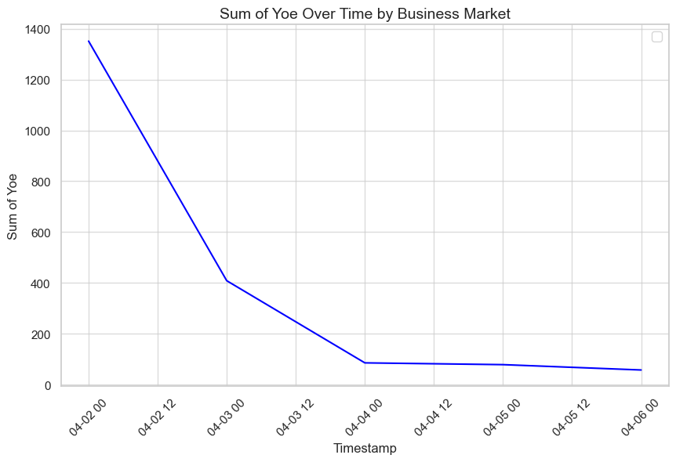
Peak Employment Date

Slide 51
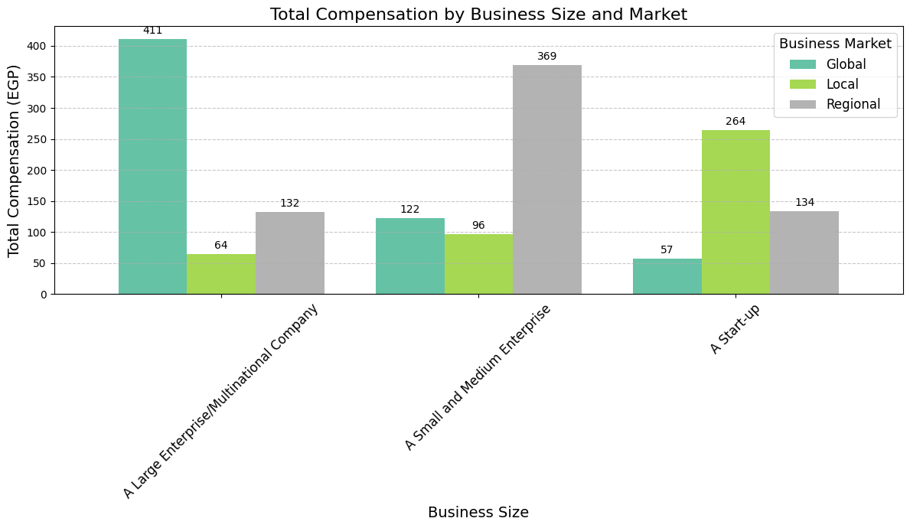

Total Compensation by Business Size and Market

Slide 52

Count of Total Compensation by Business Focus and Business Market

Slide 53

Count by 'BusinessFocus' and 'BusinessLine

Slide 54

Count of Total Compensation by Business Size

Slide 55


Count of ID_PL by Programming Languages(developers)

Slide 56

Top 6 Programming Languages for Full-stack Engineer

Slide 57


Average Compensation Ranges by Level

Slide 58

Average Total Compensation by Years of Experience

Slide 59

Average Total Compensation by Work Setting

Slide 60

Average Total Compensation by Business Size and Market

Slide 61

Cleaning with Microsoft SQL Server

Slide 62


1-Show Duplicate Data

Slide 63

2-Identify and display outliers

Slide 64

3-Exploring Empty Values

Slide 65


4-Normalization (NF-1)

Slide 66


4-Normalization (NF-1)

Slide 67


5-Normalization (NF-2)

Slide 68

5-Normalization (NF-2

Slide 69

6-Create Calendar Table

Slide 70

7-Linking Tables

Slide 71

7-Linking Tables

